Slide 1

Navigating the Airbnb Landscape in Toronto: Insights for Optimal Hosting
Tapleen Lamba
Ankit Verma
Akansha Singh
Kathia Ridore

Slide 2

Overview:
The goal of this project is to apply data analytics methodologies to understand the trends and patterns of Airbnb listings in Toronto and give the potential host an insight for their upcoming listings.
The primary focus will be on understanding the popularity of neighborhoods for short-term rentals, the distribution of room types in the most popular neighborhood, and the relationship between number of reviews and actual ratings.

Slide 3

Objectives:
Identify the most popular neighborhood for short-term rentals in Toronto.
Finding out the revenue for airbnb and to see the correlation of price with other variable
Analyze the relationship between number of reviews and actual ratings.

Slide 4

Data:
The data set is sourced from Airbnb (obtained by Kaggle), which provides public data about listings in Toronto. The data set includes several features like location, room type, price, number of reviews, and ratings.

Slide 5
Methodology:
The analysis includes a mix of statistical analysis, data visualization, and correlation analysis.

Slide 6
Data Cleaning
Ensure all the data has every column filled out, leading to 10687 total rows
Change the data type of the price variable from an object to a float, so that calculations and graphs can be done on this variable

Slide 7
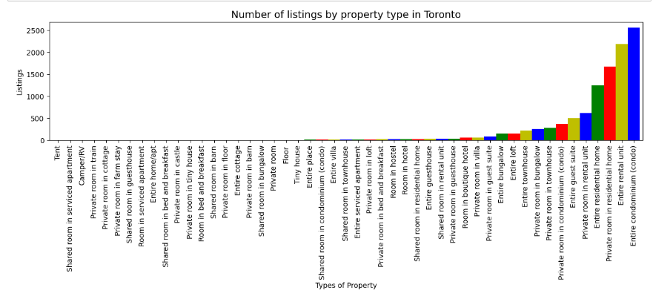
ANALYSIS/ VISUALIZATION
Determinant 1 : Price
This graph represents the number of listings by property types in the Toronto area , as it can be seen in the graph there are multiple types of properties however there are only few which are prominent.

Slide 8
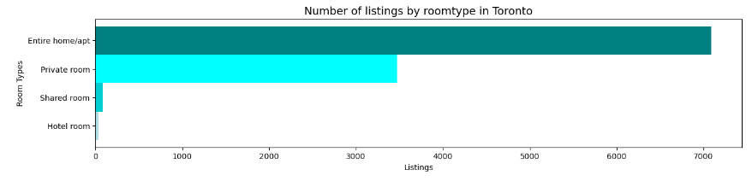
In this horizontal bar graph, we can see that there are 4 types of listings that can be categorized by Room type
and out of the 4 room types entire home /apt has the most listings that is close to 7000.

Slide 9
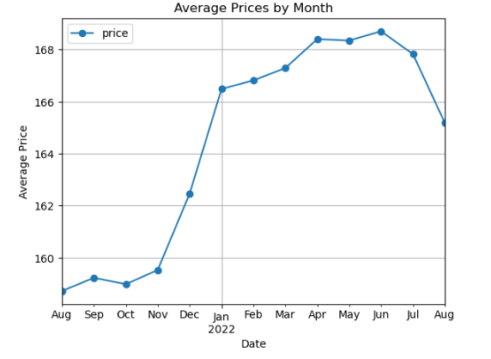
Based on the line chart presented here we can see that the Airbnb would be most expensive in June for the Toronto area, while October will be the least expensive in terms of the prices .
There is a sudden drop in prices after July and sharp increase from Nov to January.

Slide 10
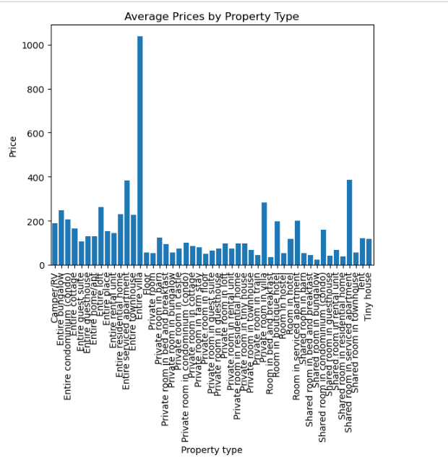
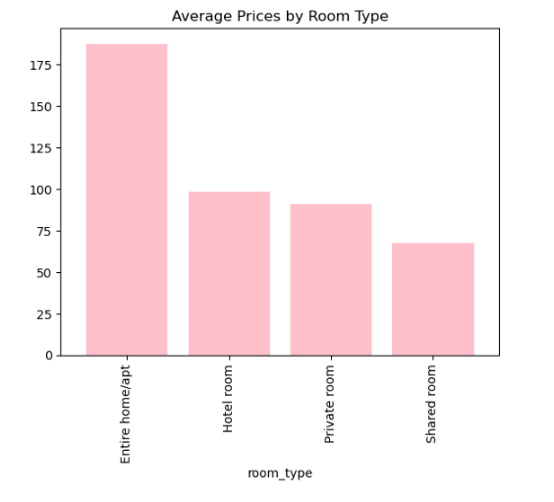
The above 2 bar graph represents the average price per room type and property type. Based on the chart , it is clear that entire villa is more expensive than other property types and that is reflected in room types.

Slide 11
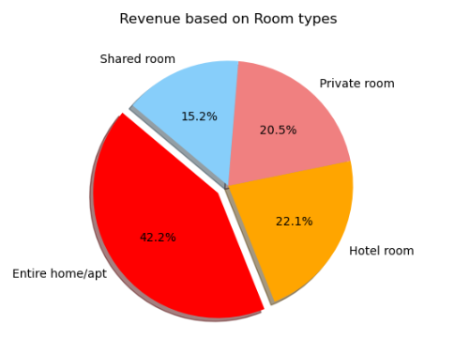
This Pie chart represents the revenue based on the room types , and it shows that even though the average price for the entire home is high still it collects the most revenue and is leading the chart board with 42.2%.

Slide 12
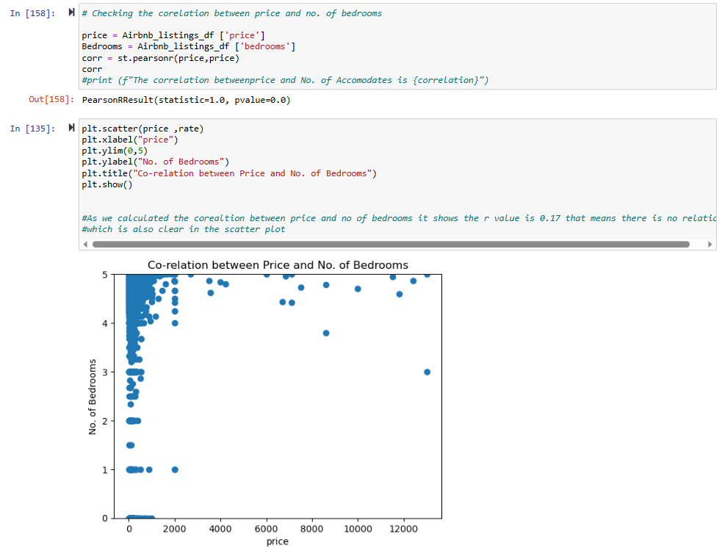
Correlation of Price with other variables
As we calculated the correlation between price and no of bedrooms it shows the r value is 0.17 that means there is no relation which is also clear in the scatter plot.

Slide 13
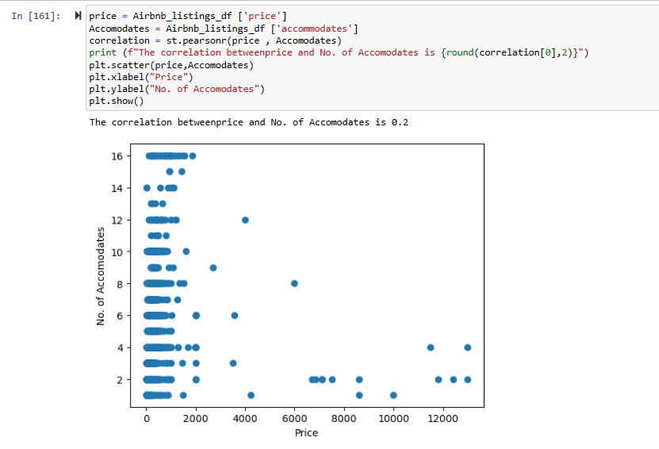
As we calculated the correlation between price and no of accommodates it shows the r value is 0.2 that means there is no relation
which is also clear in the scatter plot.

Slide 14
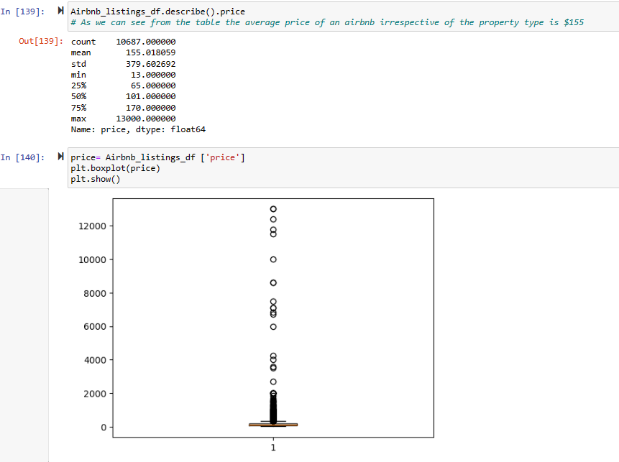
Central Tendency and Finding the outliers
As mentioned, the mean price is $155 irrespective of the property type but there is a huge variance.
The box and whisker shows that there are many outliers present in the data.

Slide 15
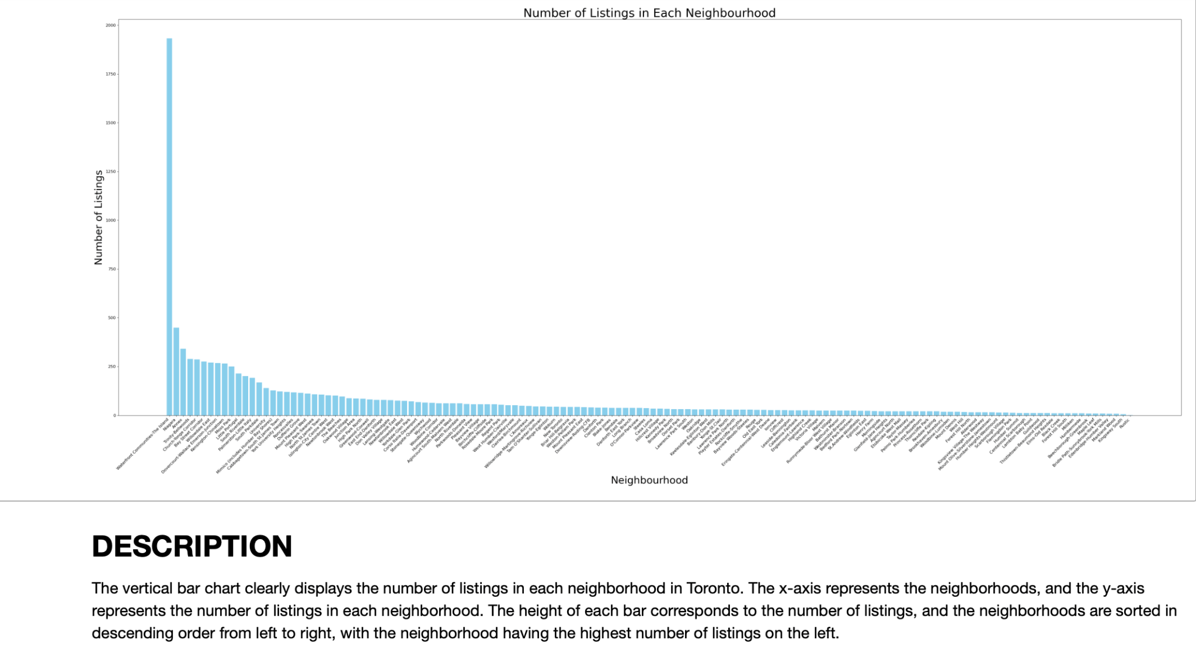
Number of Listings in each Neighborhood

Slide 16
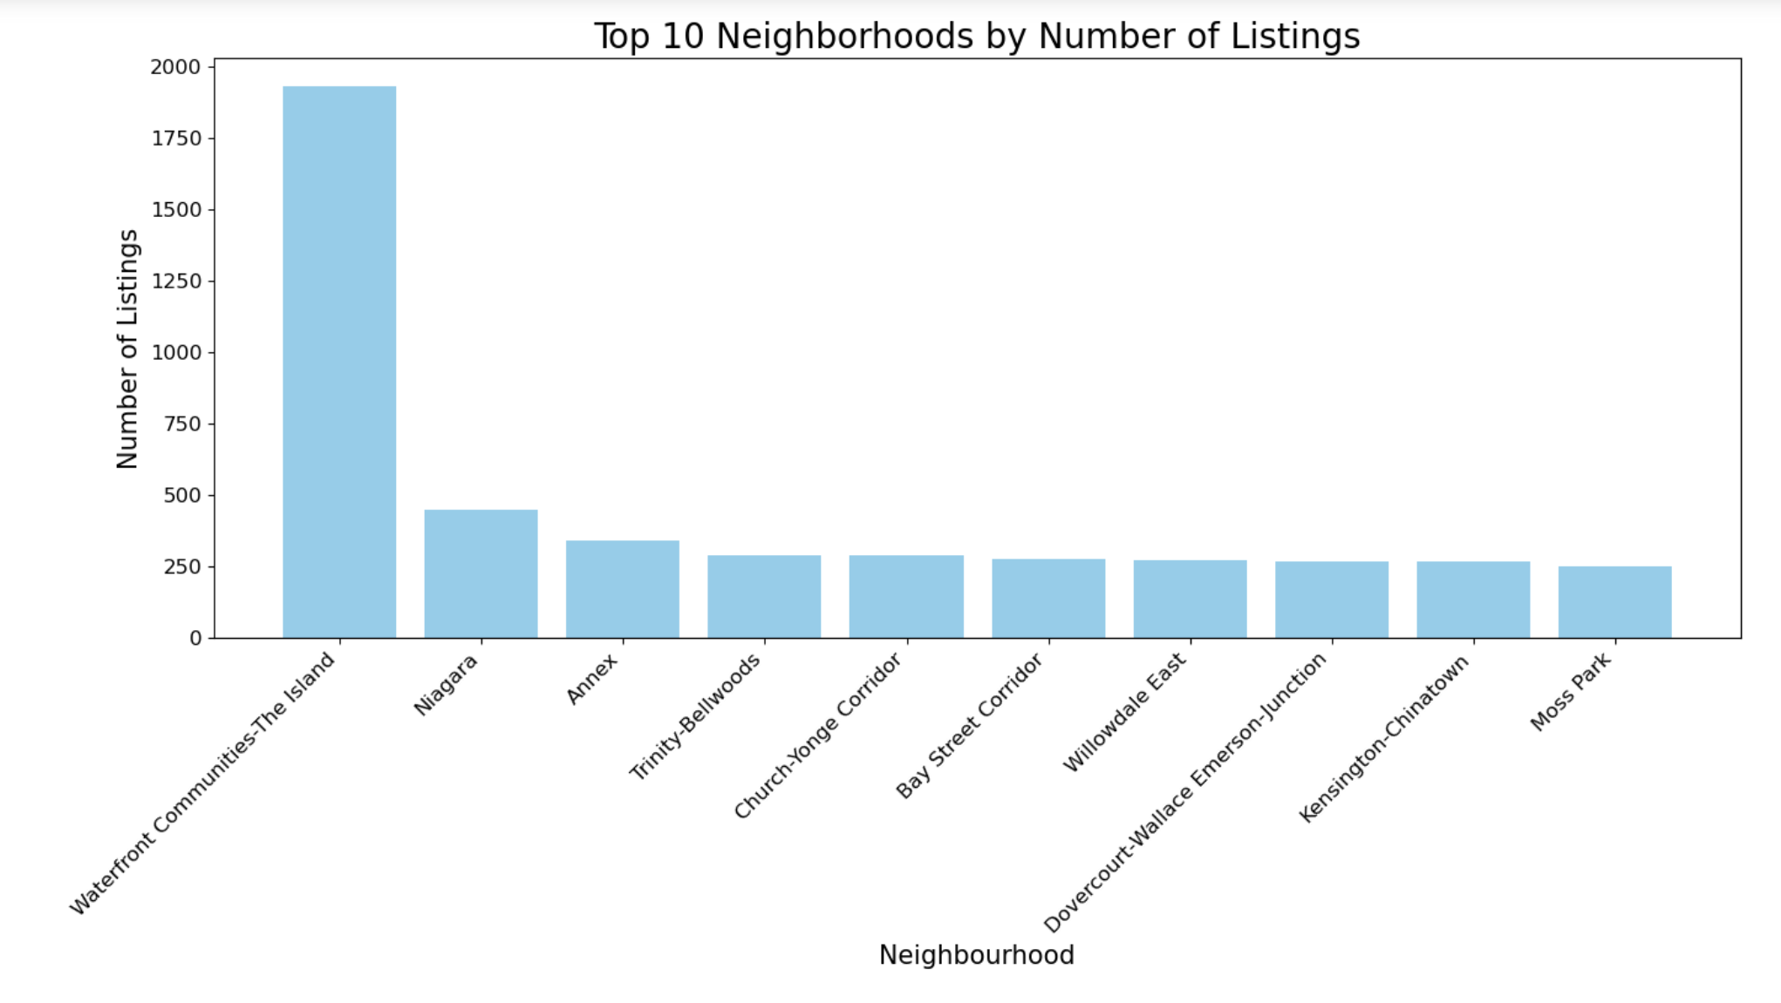
Highest number of listings, indicating Waterfront’s popularity among hosts and guests.
Potential for higher occupancy rates and rental income for investors and property owners.
Most Popular Areas

Slide 17
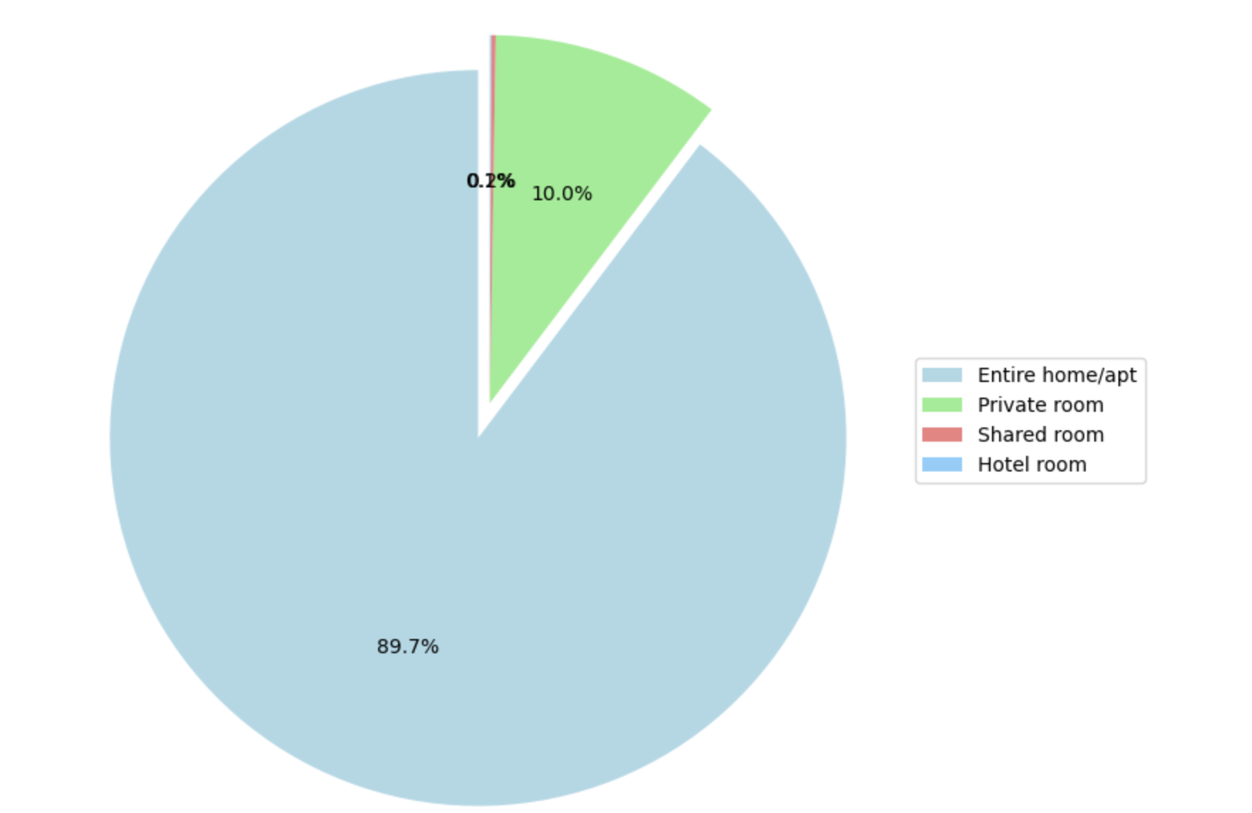
Majority of listings: "Entire home/apt” followed by "Private room" and "Shared room" options.
Guests prefer more privacy and space.
Hosts can attract more guests and potentially higher income by offering entire homes/apartments.
Distribution of Room Types in Waterfront

Slide 18
WHICH IS THE MOST POPULAR NEIGHBOURHOOD FOR SHORT TERM RENTAL IN TORONTO?
"Waterfront Communities-The Island" is the prime choice for short-term rental investment in Toronto.
Focusing on entire homes/apartments can maximize rental income and attract more guests.
Understanding the factors behind its popularity can inform marketing and property management strategies.

Slide 19
Do reviews have any benefits to an Airbnb host when listing a property?
Question 2

Slide 20
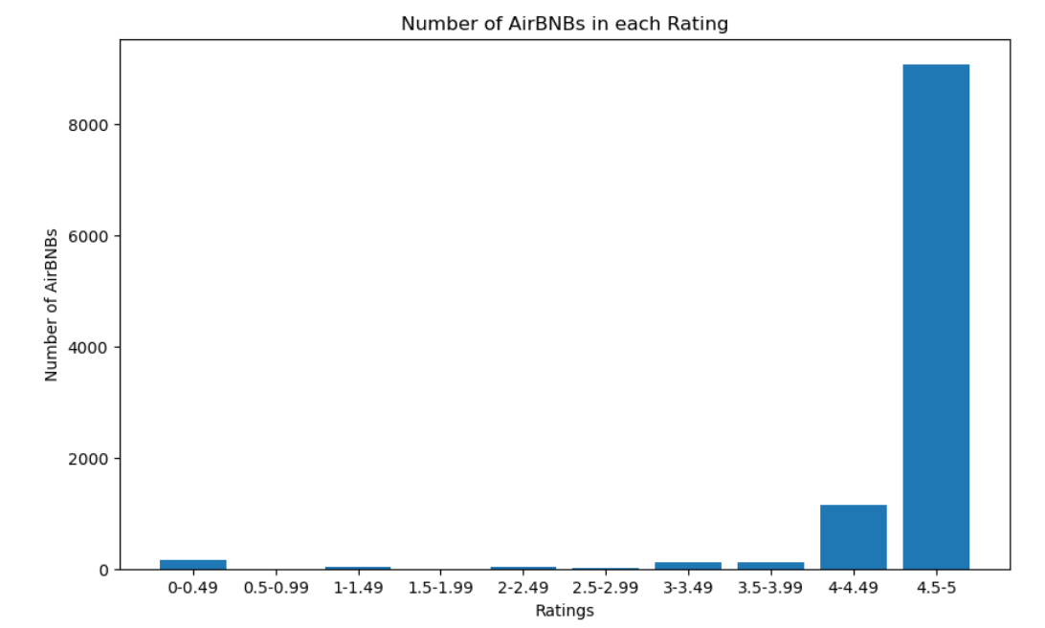
Mean: 4.66
Median: 4.85
Standard Dev: 0.71
Majority of AirBNBs are between 4.5 and 5 stars

Slide 21
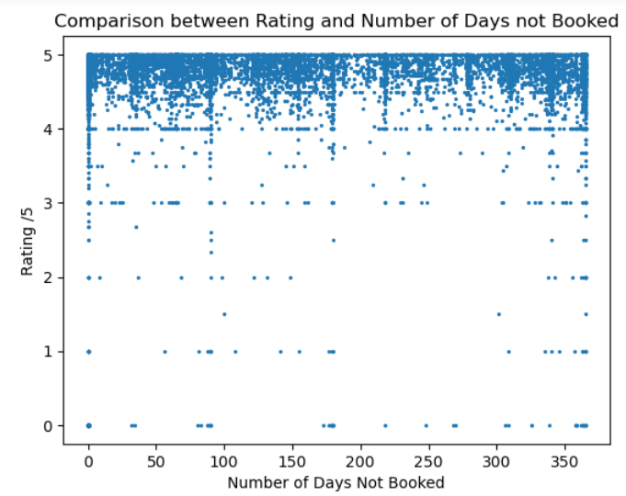
Correlation = 0.01623

Slide 22
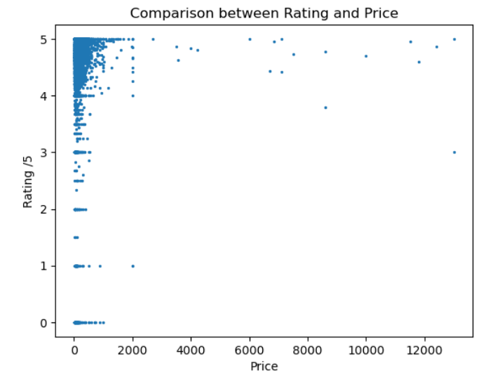
Correlation = 0.046

Slide 23
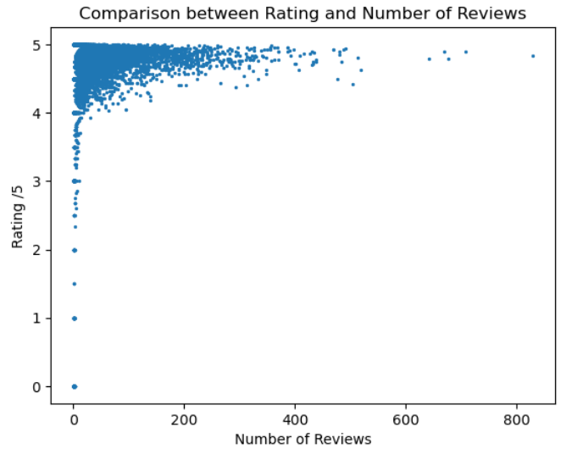
Correlation = 0.1026

Slide 24
Conclusions
Therefore, all these calculations show that, while most AirBNBs have high reviews, the benefit of these reviews to hosts are unclear.
This may be because so many AirBNBs in Toronto have very high reviews.
In conclusion, maintaining high reviews is important but does not make an AirBNB stand out.

Slide 25

Conclusion:
The application of data analytics to Airbnb listings in Toronto has yielded significant insights, providing potential hosts with critical information for their upcoming listings.
The most popular neighborhood for short-term rentals in Toronto is the "Waterfront Communities-The Island". Its popularity presents considerable opportunities for real estate investors or property owners who are considering venturing into short-term rentals. To fully capitalize on this opportunity, understanding the elements contributing to its popularity will be crucial in informing marketing strategies and property management decisions.
When it comes to room types, "Entire home/apt" is the most dominant in the most popular neighborhood, suggesting that guests value privacy and space. This trend points to a potential growth area for hosts: concentrating on offering entire homes or apartments could lead to an increase in guests and, by extension, rental income.

Slide 26

Conclusion:
However, our analysis also revealed an interesting phenomenon concerning reviews and ratings. Despite most Airbnb properties in Toronto having high reviews, these reviews do not seem to offer a significant advantage to hosts, likely due to the consistently high ratings across the board. Therefore, while maintaining high reviews remains important, it does not necessarily set a listing apart. It suggests that hosts may need to diversify their strategies beyond just ratings to truly differentiate their listings in this competitive market.
In summary, understanding these trends and patterns can help hosts and investors make informed decisions to optimize their Airbnb operations in Toronto. This data-driven approach is essential in today's rapidly evolving short-term rental landscape.

